Slide 1
June 26, 2023

Slide 2
Introduction to Applied Data Science in Python
QBS 101.5
Simon Stone✤, Jeremy Mikecz ✤, Carly Bobak✦
✤Research Data Services, ✦Research Computing
Dartmouth College

Slide 3
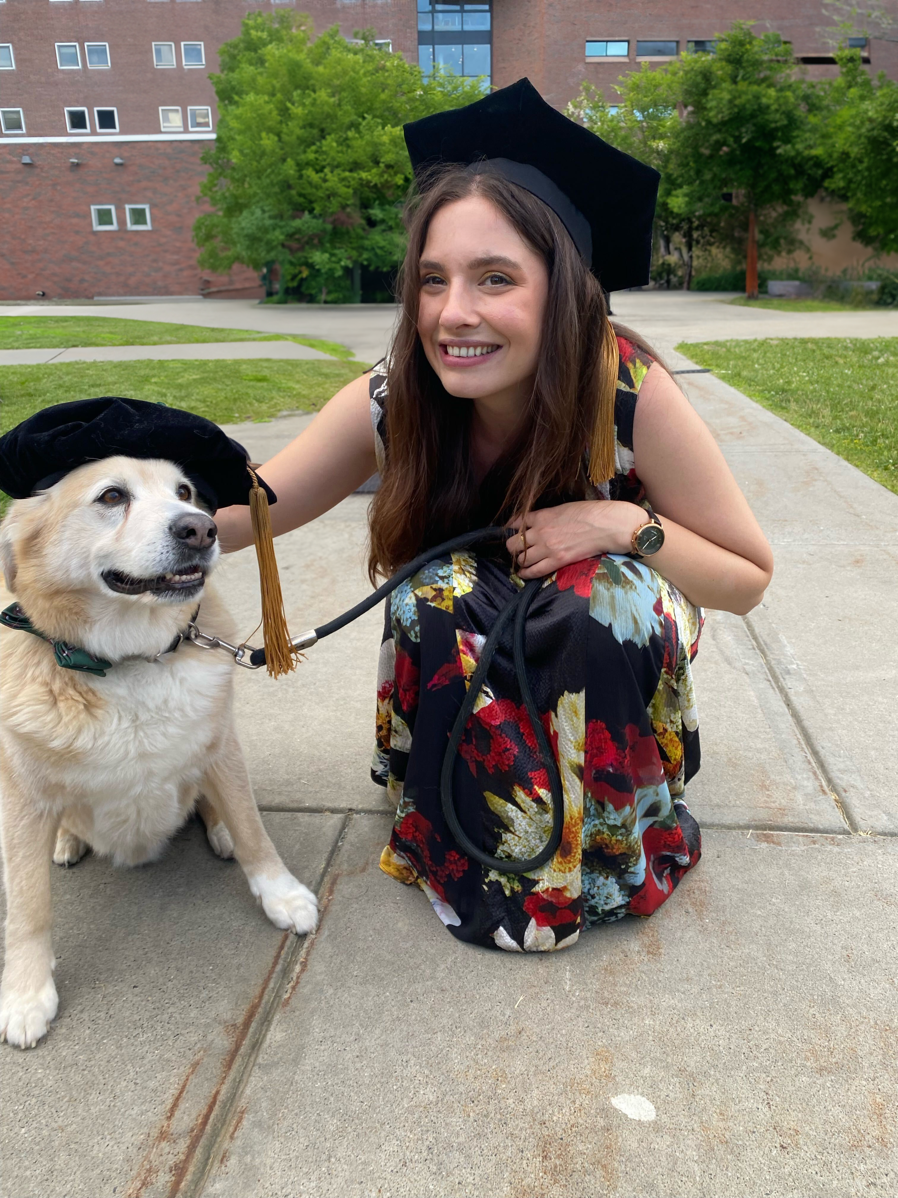


Applied Data Science in Python Instructors
Carly Bobak, PhD
Biomedical Informatics Specialist
PhD in Quantitative Biomedical Sciences from Dartmouth College (2021)
Teaches QBS 181: Data Wrangling
Published papers on diverse public health issues, including TB, Covid, HIV, cancer, sepsis, smoking cessation, and obesity.
Has two dogs who tend to crash QBS events
Jeremy Mikecz, PhD
Research Data Science Specialist
PhD in Latin American History, University of California
Offers consultations and workshops on computational text analysis, data visualization, GIS and mapping, Python & R programming
Published various articles and a book (in-press) showcasing how visualization and mapping can aid historical research
Dr. Simon Stone
Research Data Science Specialist
Doctoral degree in Electrical and Computer Engineering from Technische Universität Dresden
Offers consultations and workshops on Data Science, Machine Learning, and Software Development
Published papers on speech technology, sensor design, signal processing, and machine learning
Freelance software developer by night

Slide 4



Applied Data Science in Python Course materials
Brand new class!
Materials are created as we go along
You can help shape them!
Materials will consist of lecture slides and code-along notebooks
Class repository:
https://github.com/Simon-Stone/qbs-applied-data-science
Get the materials:
git clone https://github.com/Simon-Stone/qbs-applied-data-science
Update the materials:
git pull

Slide 5



Introduction Data Science
Data science is the study of data to extract meaningful insights for business.
Challenge:
Define Data Science!
https://aws.amazon.com/what-is/data-science/
Data science […] uncover[s] actionable insights hidden in an organization’s data.
https://www.ibm.com/topics/data-science
[Data science] models and analyzes key data to continually improve how businesses utilize data.
https://cloud.google.com/learn/training/machinelearning-ai

Slide 6
Introduction Data Science
Data Engineer
Data Analyst
Machine Learning Engineer
Collect
Clean
Clean
Build and assess model
Exploratory Data Analysis
Model implementation
Deployment
Data Scientist
Data Science is OSEMN!*
Obtain
Scrub
Explore
Model
iNterpret
*pronounced “awesome” - /ˈɔ.səm/ https://www.datascience-pm.com/osemn

Slide 7

Outline
Introduction
Schedule
Learning Objectives
What makes a Data Science project special?
What makes a Python project special?
Tools of the Trade
Summary
Assignment
Munroe, R. (n.d.). Data Pipeline. xkcd. https://xkcd.com/2054/ (CC BY-NC 2.5)

Slide 8
Learning Objectives
Complete a data science project through the process of finding, cleaning, compiling, exploring, analyzing, visualizing, and modeling data.
Become proficient at writing and applying Python code to complete these data science steps.
Practice effectively communicating (and providing critical feedback on) data science research.
Apply the principles of reproducible research throughout the data science lifecycle.

Slide 9
Format
Class times and location:
Monday, 4 pm – 5:30 pm
Wednesday, 4 pm – 5:30 pm
Remsen 312
Classes will consist of lectures, code-alongs, hands-on project work, or a mix of all the above
There will be assignments to continue the engagement with each week’s content
At the end of each Wednesday class, there is time for project check-ins, show & tell, or troubleshooting
Each student is expected to hand in a final project

Slide 10
Format Final Project
Project requirements:
Devise a business or research question that can be answered through data
Identify a suitable dataset
Implement all major steps of a data science project to find an answer to the chosen question
Deliverables:
Project pitch (details to come)
Fully reproducible project repository
Final presentation

Slide 11
Schedule
Week 1 (June 26 & June 28):
Getting Started with Applied Data Science & Python
Introduction to Applied Data Science with Python
Data Wrangling
Week 2 (July 3 & July 5):
Texts, Maps, and Graphs
Data Visualization
NLP I
Week 3 (July 10 & July 12):
Texts as Data
NLP II
NLP III
Week 4 (July 17 & July 19):
Machine Learning
Scikit-learn
PyTorch
Week 5 (July 24 & July 26):
Project Work
Project proposals due (Monday July 24)
No class meetings
Week 6 (July 31 & August 2):
No class meetings
Week 7 (August 7 & August 9):
Collaboration and Documentation
Documenting, Sharing and Evaluating Code
Peer Review
Week 8 (August 14 & August 16):
Code Revision Work
No Class Meetings
Week 9 (August 21 & August 23):
Final Presentations and revised code due (Wed. Aug 23)

Slide 12
Policy on Generative AI
Use of generative AI is generally accepted in this course if it meets the following requirements:
You are expected to take full ownership of your work, including the use of generative AI
You need to be able to understand and reflect any output of generative AI you want to include in your work
“It’s a tool, you’re its master!”
Just like with code taken from other sources (e.g., Stack Overflow), any code other than your own must be cited (see Week 7: Documentation)
You are expected to be able to explain and discuss every line of code in your final project

Slide 13
Applied Data Science with Python What makes a Data Science project special
Typical project has two phases:
Exploration phase
Explore data, imputations, feature engineering, model selection
Reporting and “deployment” phase
Generate result tables and graphs, refactor code, export trained models
Subject matter domains differ, tasks are similar
Multiple stakeholders to consider, “interrogate”, and convince

Slide 14
Applied Data Science with Python What makes a Python project special
Powerful language with incredible community and industry support
Often large number of (inter-)dependencies
Rapid prototyping
(Mostly) cross-platform compatible on Windows, Mac OS, Linux
Sprawling, sometimes confusing ecosystem
Deployment / reproducibility can be challenging

Slide 15
Applied Data Science with Python Tools of the Trade
Integrated Development Environment (IDE) for writing code
Command line scripts for project setup and configuration
Jupyter notebooks for prototyping and reporting
Version control for code (and sometimes data)
Not part of this course:
Cloud infrastructure (Amazon Web Services, Google Cloud, Microsoft Azure)

Slide 16
Tools of the Trade Anti-patterns
“A commonly-used process, structure or pattern of action that, despite initially appearing to be an appropriate and effective response to a problem, has more bad consequences than good ones.”
Gang of Four*
Not using an IDE
Not organizing your project in one place
Using a too simple or too elaborate project setup
Overusing Jupyter notebooks (sometimes scripts are better)
Not managing your Python environment
* Gamma, E., Helm, R., Johnson, R., Vlissides, J. (1995). Design patterns: elements of reusable object-oriented software. Boston, MA, USA: Addison-Wesley Longman Publishing Co., Inc.. ISBN: 0-201-63361-2

Slide 17

Tools of the Trade Recommended Setup for this class
Recommended Python distribution:
Vanilla Python 3.8 or newer: https://www.python.org/
Recommended IDE:
Visual Studio Code: https://code.visualstudio.com/
Recommended version control hosting platform
GitHub: https://www.github.com

Slide 18
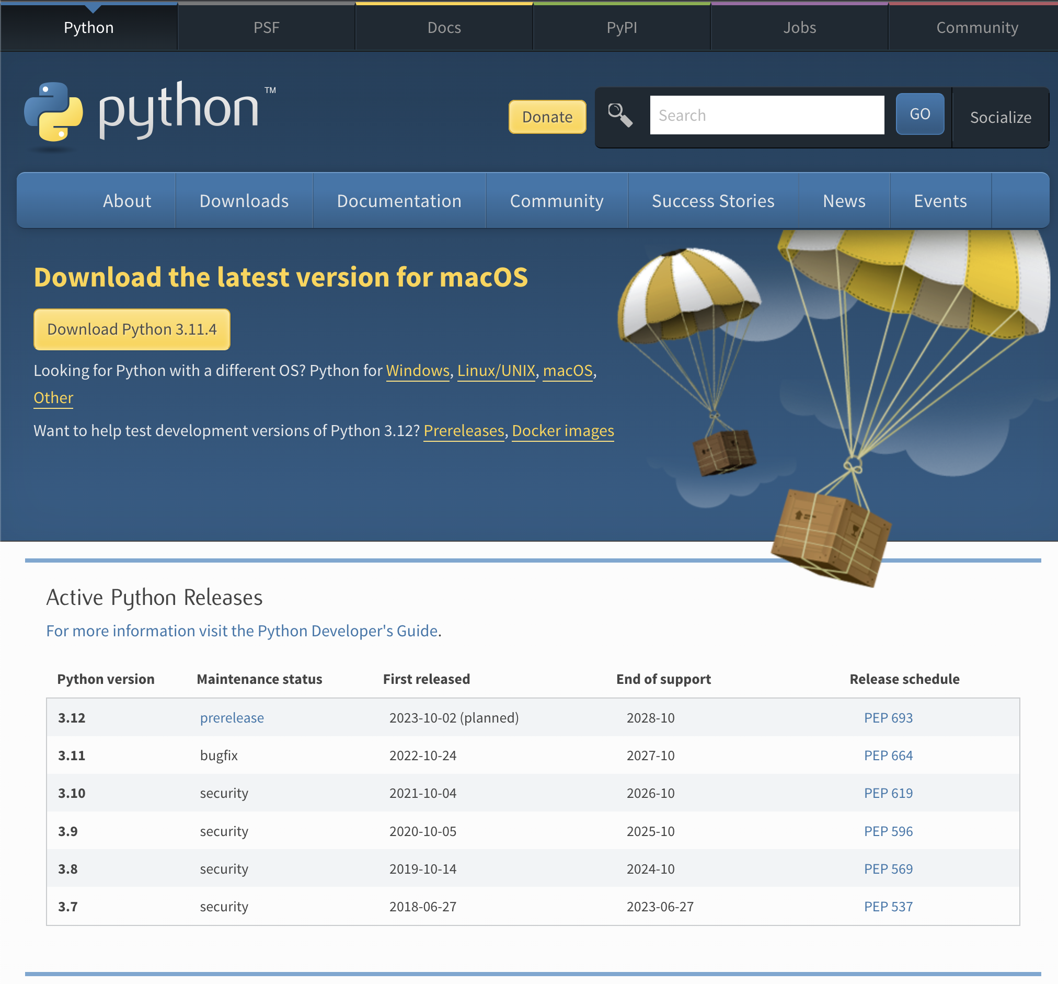
Tools of the Trade Python
Recommended minimum version 3.8+
Installer from python.org recommended
Recommended environment management:
Using Python’s built-in virtualenv: https://docs.python.org/3/library/venv.html
Install packages into virtual environment
Document project requirements using:
pip freeze > requirements.txt
https://www.python.org/downloads/

Slide 19

Tools of the Trade Python
Python is supported by Jupyter notebooks
Notebooks are a convenient way to combine code, text, and images in a single file
Notebooks are great for developing a narrative in your analysis
Notebooks are not a good choice for project setup, config, or model deployment
Use regular Python scripts (*.py) for that

Slide 20
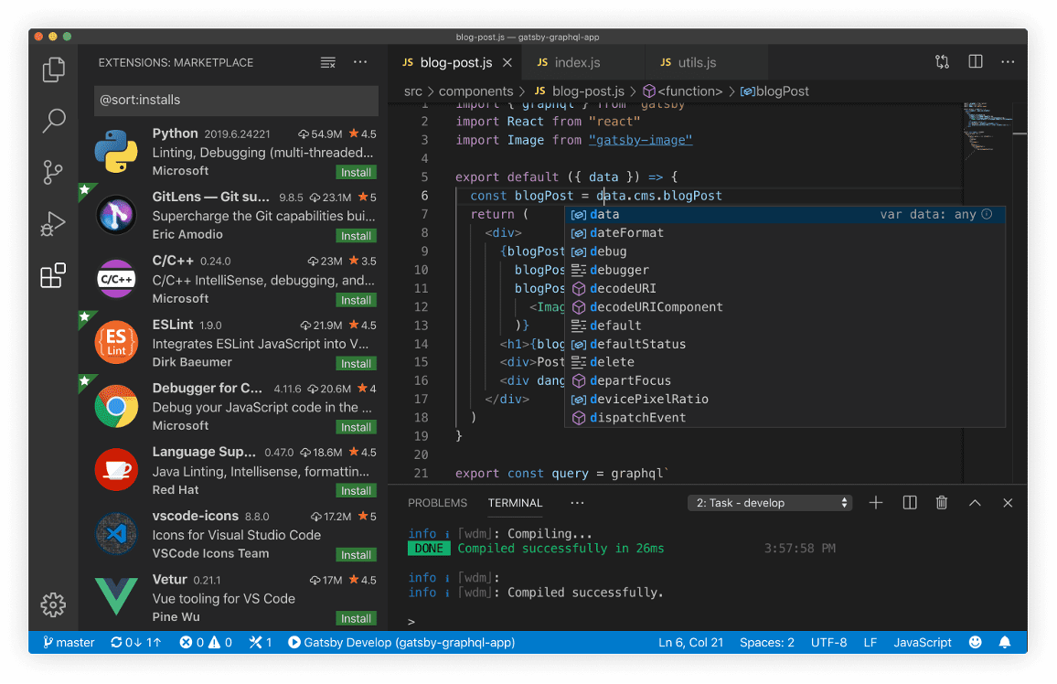
Tools of the Trade Visual Studio Code
Cross-platform (Windows, Mac, Linux)
Open source
Lightweight (no project files required)
Support for all sorts of languages
Syntax highlighting and autocomplete
Extensible in millions of ways
Natively supports Jupyter notebooks
Git built-in
Easy to get started
Many powerful advanced features
https://code.visualstudio.com/

Slide 21
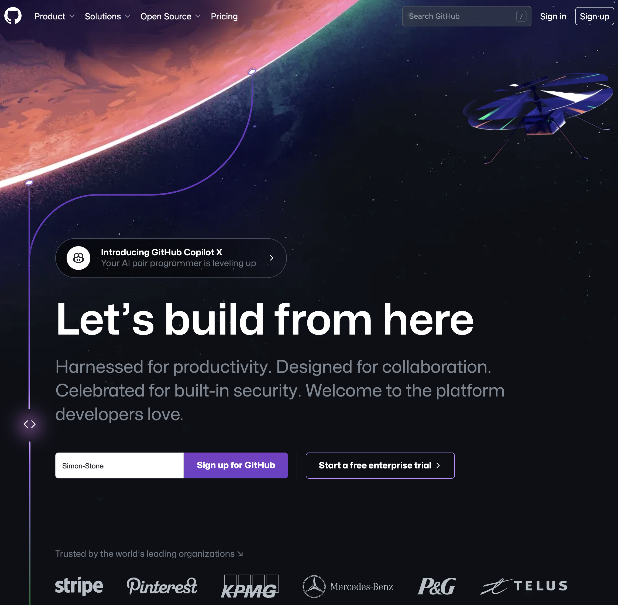
Tools of the Trade GitHub
Web-based platform for individuals and teams to collaboratively develop software projects
Uses the Git version control system
Also offers tools and services for
project management,
continuous integration and deployment,
documentation
Building up portfolio of projects on GitHub can benefit your job applications
https://www.github.com/

Slide 22
Tools of the Trade GitHub
Repository structure:
Many templates available on the internet:
http://drivendata.github.io/cookiecutter-data-science/
https://gist.github.com/ericmjl/27e50331f24db3e8f957d1fe7bbbe510
Try them out, learn what works, adjust and adapt to fit your flow
Consider creating a GitHub template repo

Slide 23
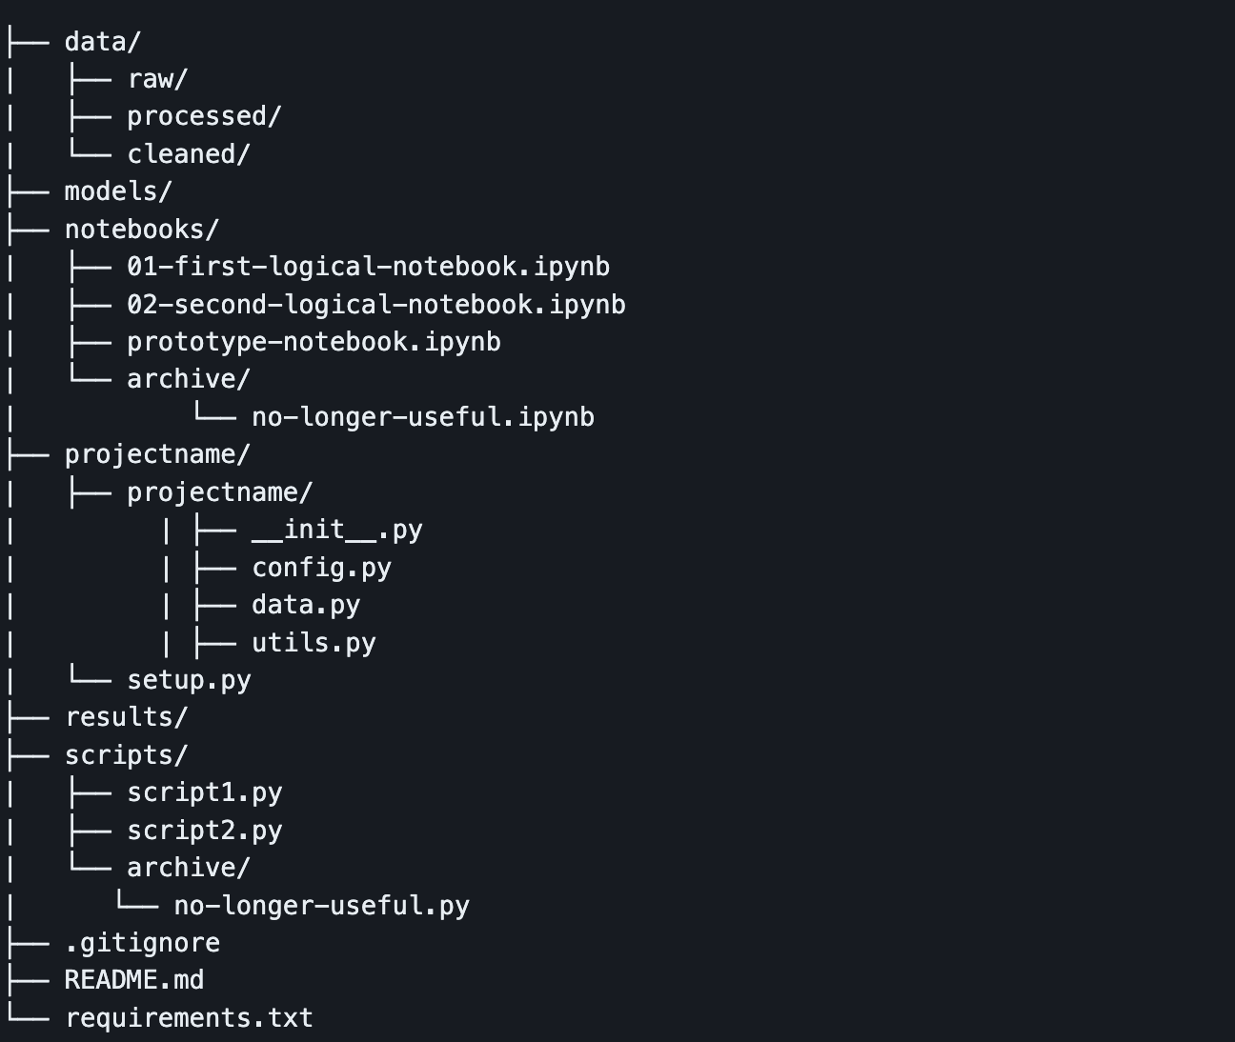
Tools of the Trade GitHub
An example structure you can use in this class:
Tour of the example repo
Not all of this will be helpful in every project
https://github.com/Simon-Stone/data-science-project-repo

Slide 24
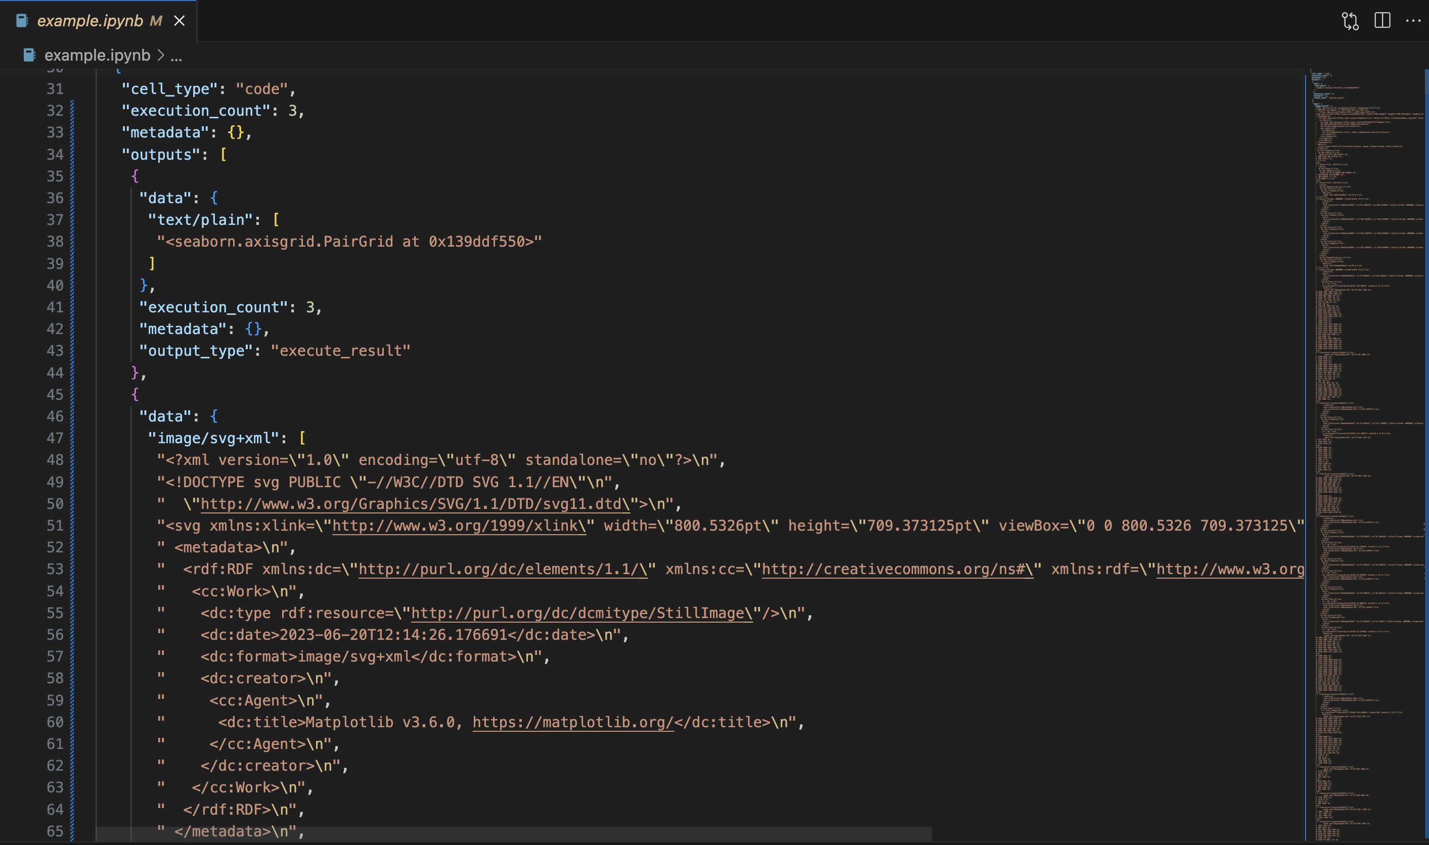
Tools of the Trade Bonus tip: Jupyter notebooks in Version Control
The problem:
Jupyter notebooks contain metadata, binary blobs, or other artifacts from execution
Git tracks changed lines in text files
Diffs become almost meaningless
Solution:
Always clear the output before committing
Use pre-commit hooks
Use nbstripout (https://github.com/kynan/nbstripout)

Slide 25
Assignment
Set up a skeleton project repository
Start thinking about a ”business/research question” you want to explore in your project
Start thinking about the kind of data you want to work with
Start looking for corresponding data
Is it already available as a dataset? API? Possible and allowed to scrape?

Slide 26
Thank you

